Slide 1



INSTITUTE-UIE
DEPARTMENT- AU-1 to 5
Bachelor of Engineering (All Branches)
Mathematics-I (23SMT-121)
Differential Equations & its Applications
DISCOVER . LEARN . EMPOWER

Slide 2


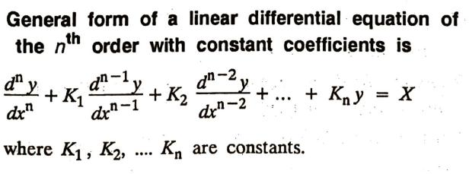
1. METHODS OF FINDING COMPLETE SOLUTION
higher order linear differential equations
with constant coefficients
3

Slide 3

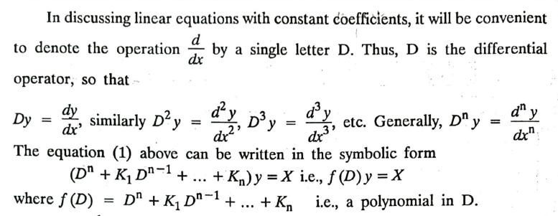
4

Slide 4

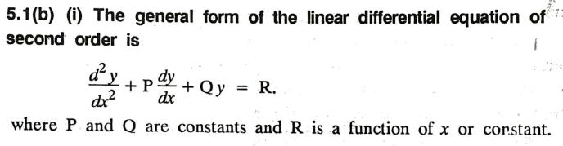


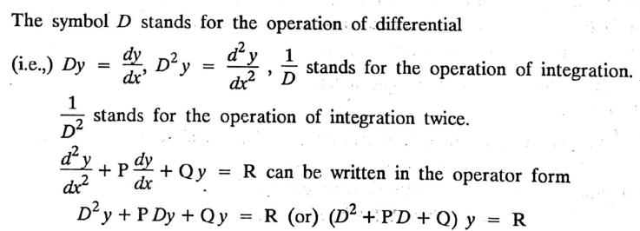
5

Slide 5

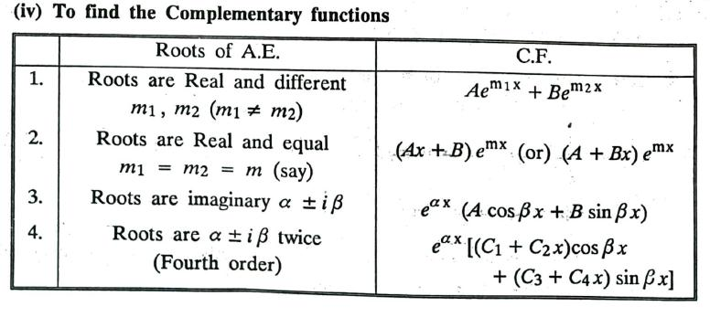
6

Slide 6

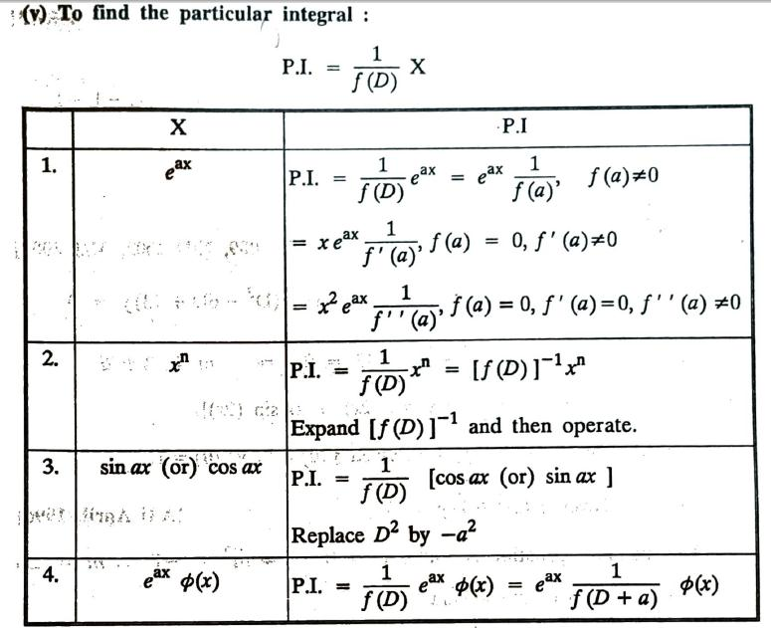
7

Slide 7

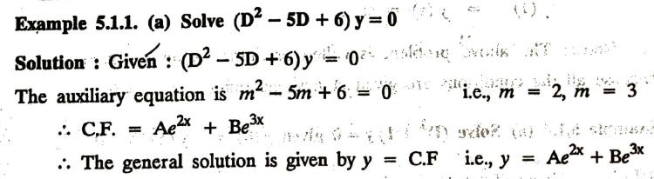
Problem:
8

Slide 8

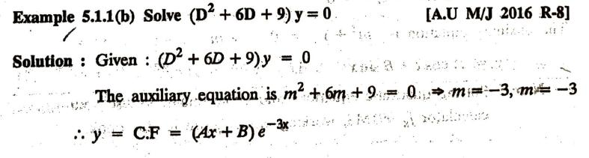
Problem:
9

Slide 9

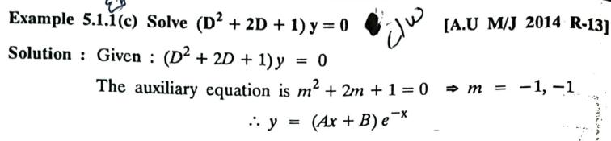
Problem:
10

Slide 10

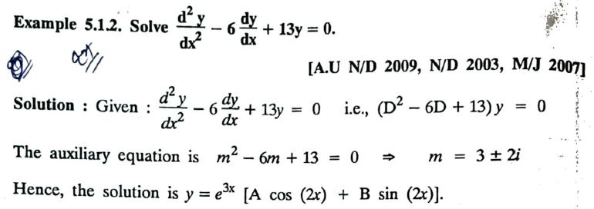
Problem:
11

Slide 11

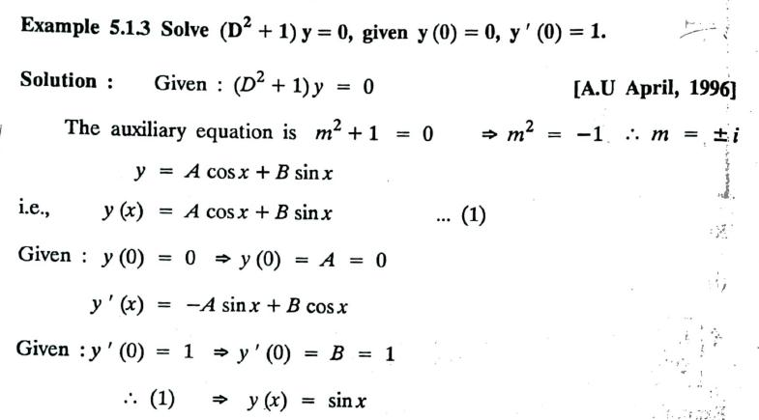
Problem:
12

Slide 12

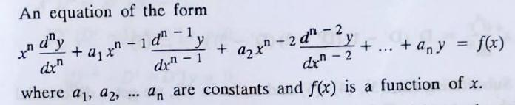
2. CAUCHY'S & LEGENDRE'S LINEAR DIFFERENTIAL
EQUATIONS
2.1. CAUCHY'S LINEAR DIFFERENTIAL EQUATIONS
Higher order linear differential equations
with variable coefficients [Cauchy’s type]
13

Slide 13

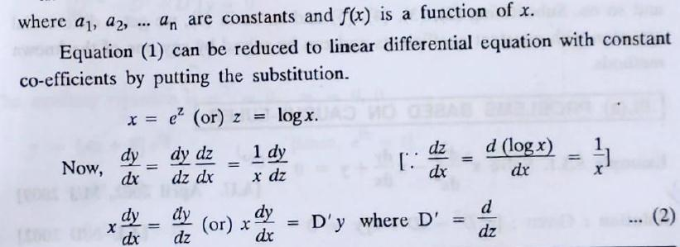
14

Slide 14

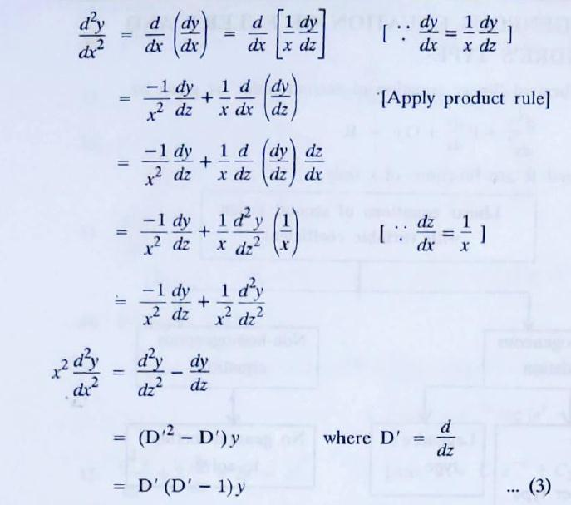
15

Slide 15

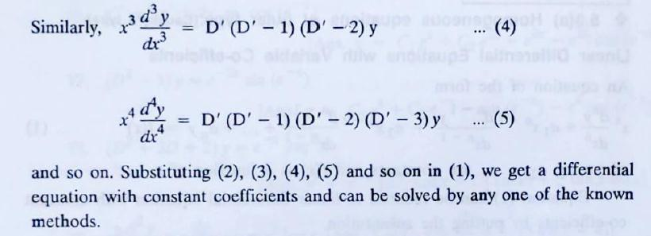
16

Slide 16



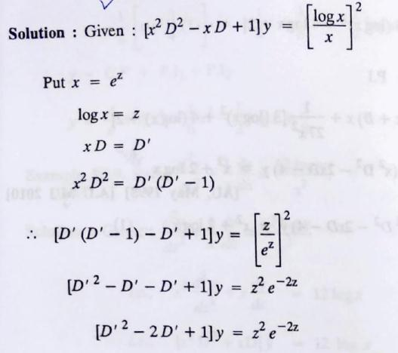
Problem:
17

Slide 17

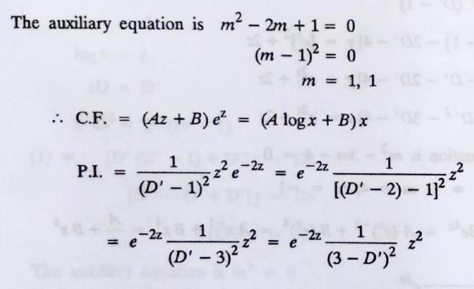
18

Slide 18

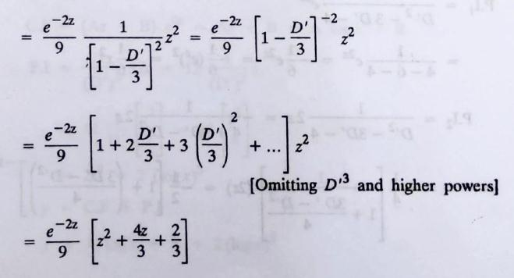
19

Slide 19

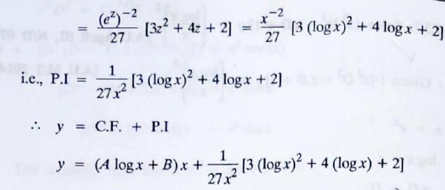
20

Slide 20



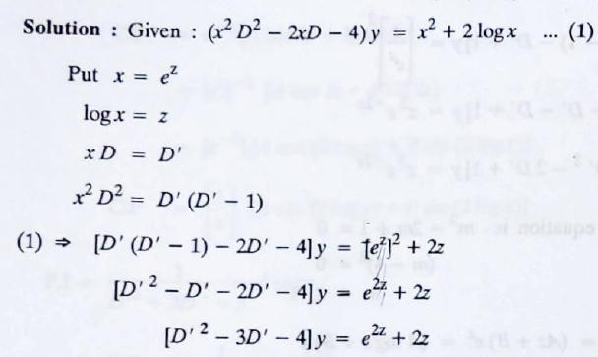
Problem:
21

Slide 21

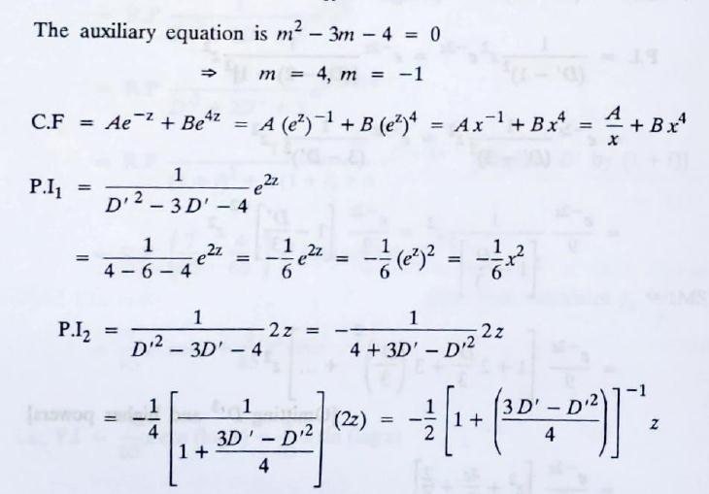
22

Slide 22

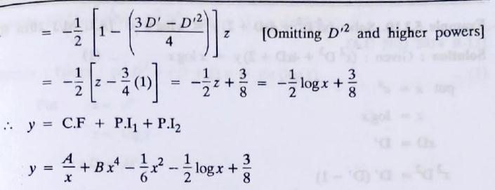
23

Slide 23



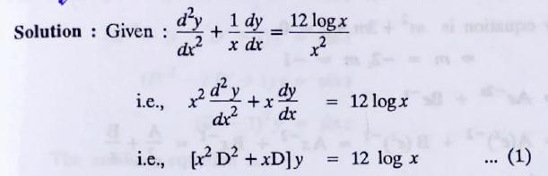
Problem:
24

Slide 24

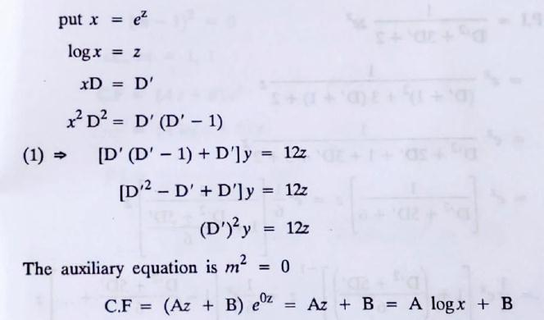
25

Slide 25

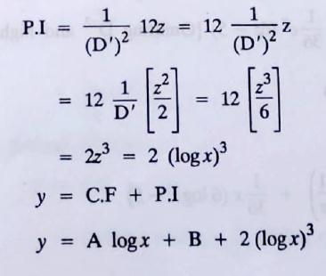
26

Slide 26



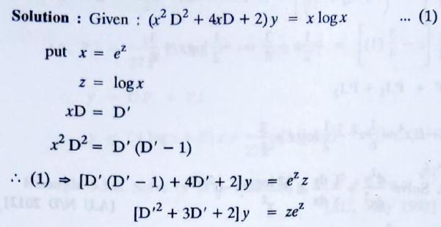
Problem:
27

Slide 27

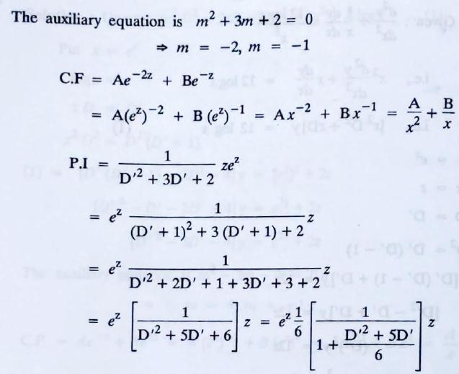
28

Slide 28

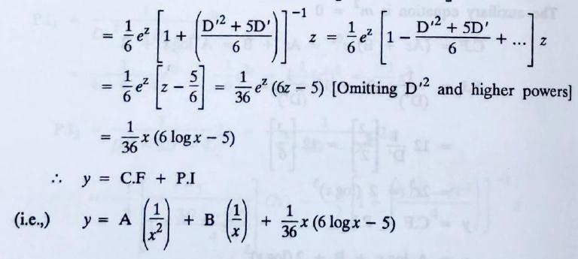
29

Slide 29



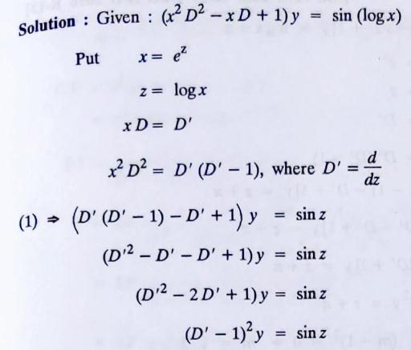
Problem:
30

Slide 30

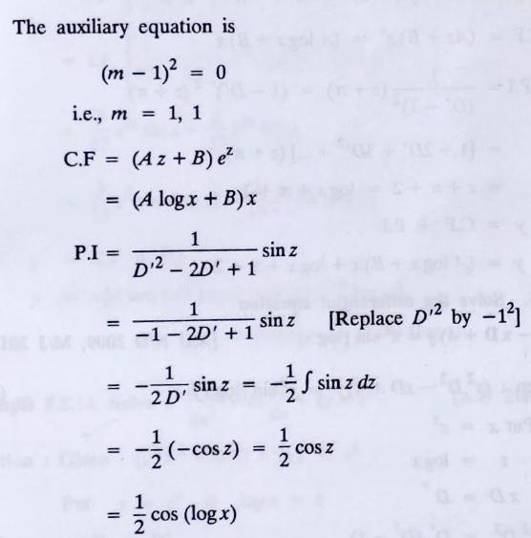

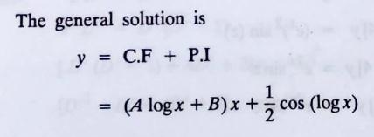
31

Slide 31

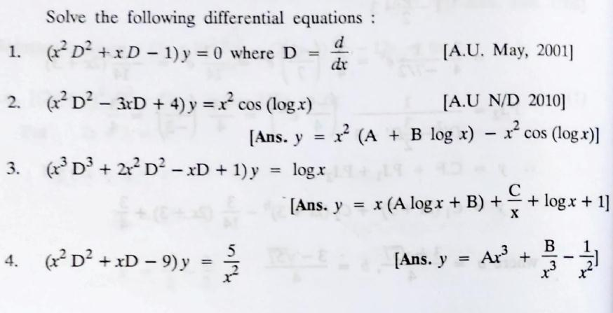

HOME WORK [Cauchy’s Type]
32

Slide 32

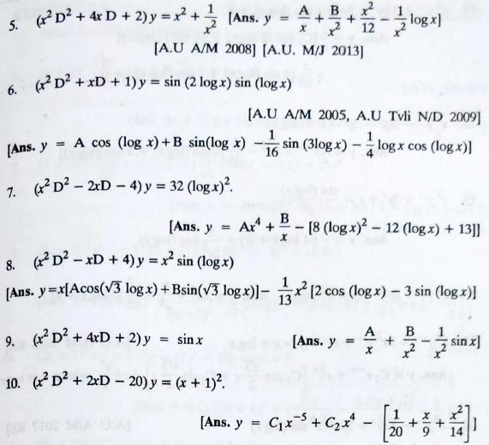
33

Slide 33

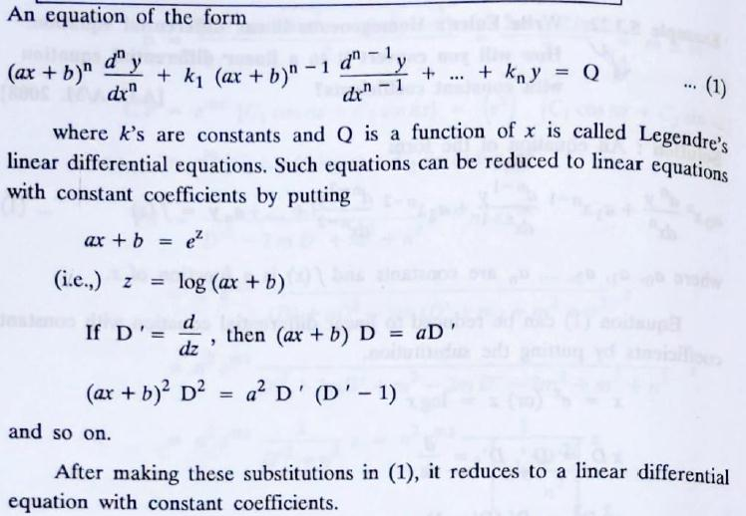
2.2. LEGENDRE'S LINEAR DIFFERENTIAL EQUATIONS
Higher order linear differential equations
with variable coefficients [Cauchy’s type]
34

Slide 34



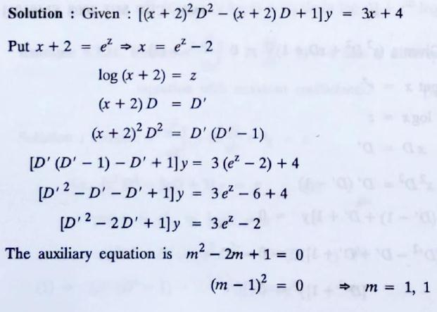
Problem:
35

Slide 35

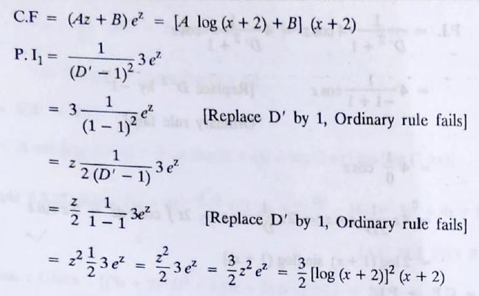
36

Slide 36

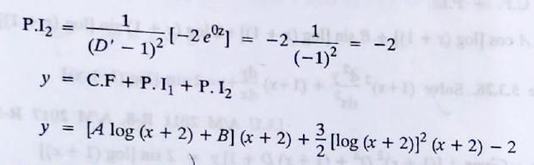
37

Slide 37



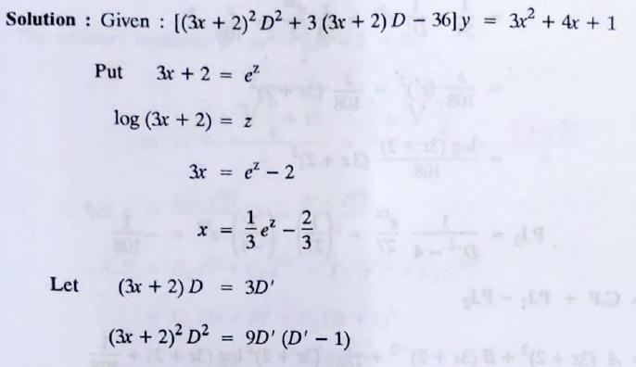
Problem:
38

Slide 38

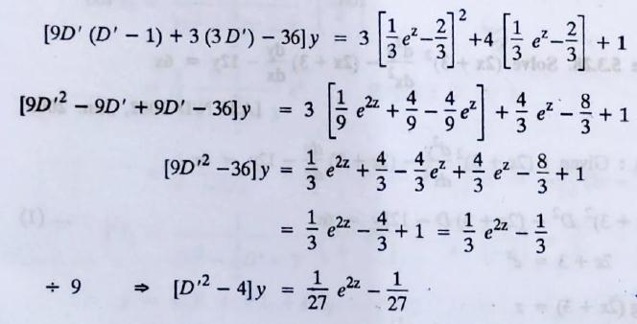
39

Slide 39

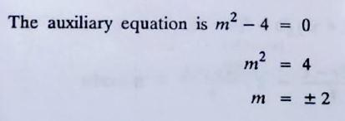

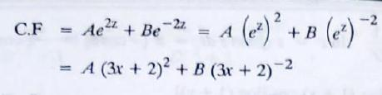
40

Slide 40

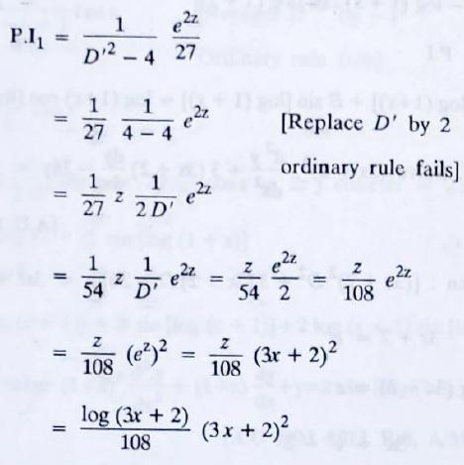
41

Slide 41

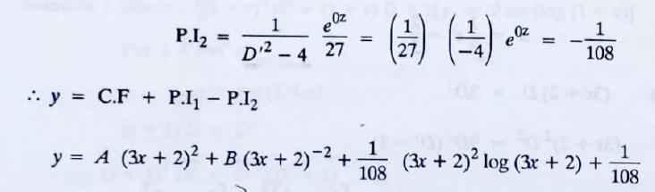
42

Slide 42



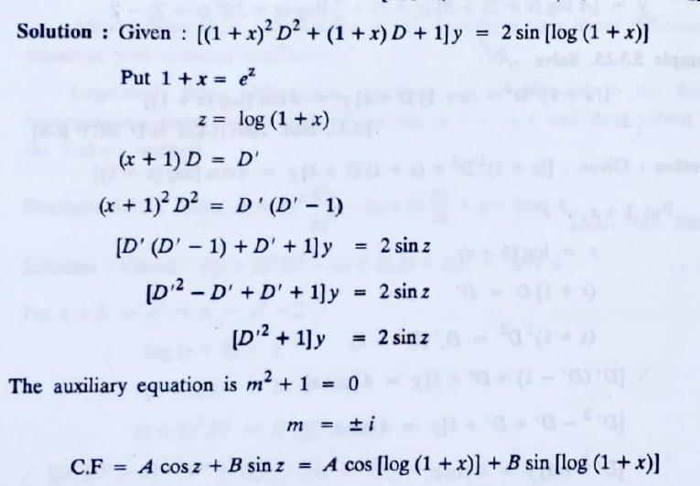
Problem:
43

Slide 43

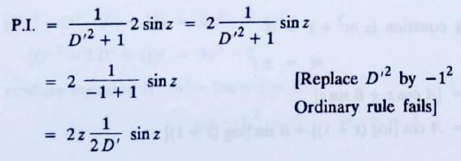

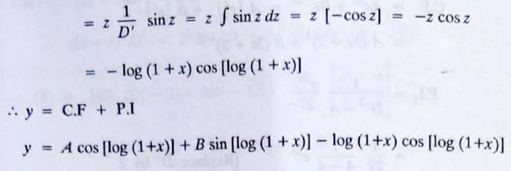
44

Slide 44

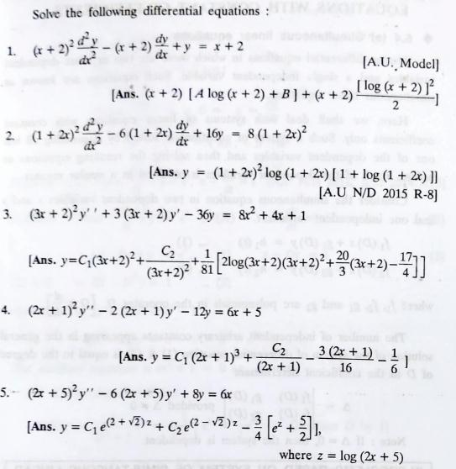
HOME WORK [Legendre’s Type]
45

Slide 45

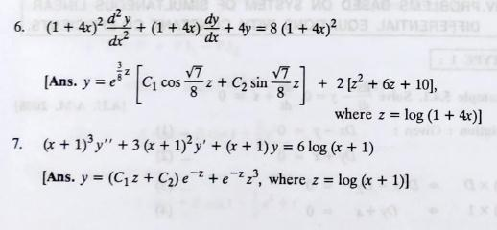
46

Slide 46

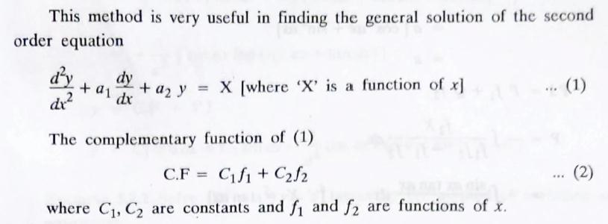
3. METHOD OF VARIATION OF PARAMETERS
47

Slide 47

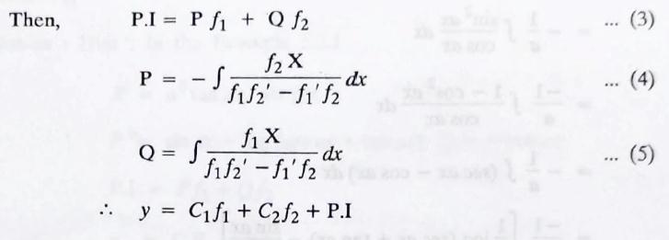
48

Slide 48







Problem:
49

Slide 49




50

Slide 50




51

Slide 51





Problem:
52

Slide 52


53

Slide 53


54

Slide 54




Problem:
55

Slide 55


56

Slide 56


4. SIMULTANEOUS LINEAR EQUATION
WITH CONSTANT COEFFICIENTS
57

Slide 57




Problem:
58

Slide 58


59

Slide 59




Problem:
60

Slide 60


61

Slide 61




Problem:
62

Slide 62


63

Slide 63




64

Slide 64


65

Slide 65
Reference Material
Text and Reference Books
Higher Engineering Mathematics by H.K.Daas
Higher Engineering Mathematics by B.S.Grewal
A text book of Engineering Mathematics by N.P. Bali and Manish Goyal
Advanced Engineering Mathematics by E.Kreyszig
Online Video Sites
NPTEL
Unacademy
Coursera

Slide 66

THANK YOU
For queries
Email: shivanibansal.maths@cumail.in

